Slide 1
THE CRYPTO ANALYZER
Phase I Design
for
Modeling Crypto Portfolios
A Project By: Chris Lars on – Farah Awad – Stephen Bernard – Cathy Slider

Slide 2
The Vision
How Did Your Crypto Portfolio Perform
vs
The Major Markets and Other Cryptocurrencies?
Our research suggests it is possible to construct the necessary dataframes, function call, and visual experience that would allow a user to compare cryptocurrency selections to major indices such as the S&P 500, Gold, and Bitcoin.

Slide 3
Questions and Data
What did we want to ask of this project?
What would the data reveal when comparing cryptocurrencies and other market indices?
Could a user of this dashboard learn the following?:
What is the risk level of my portfolio?
How are my portfolio assets correlated?
How are my assets performing relative to other assets, including benchmarks?
How can I construct a low/medium/high risk portfolio?
What and how do we define a low/medium/high risk portfolio?

Slide 4

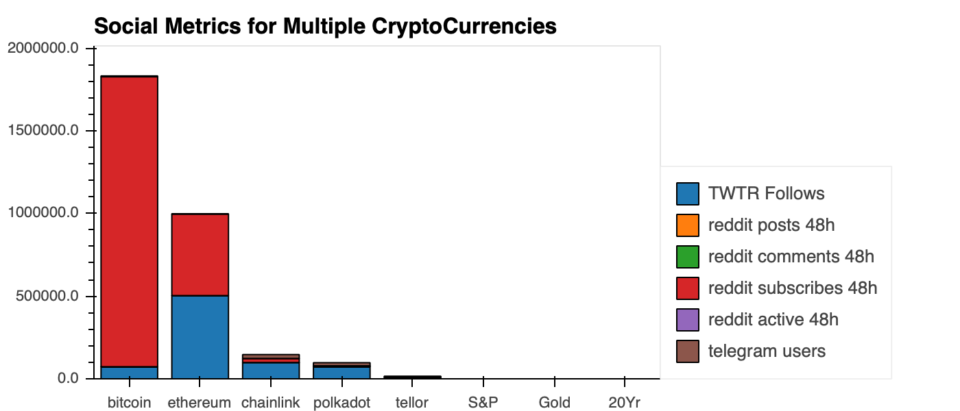
Data Cleanup and Exploration
Pull real-time and five-year historical market data for cryptocurrencies from a reliable source.
An SDK was a smart solution for importing CoinGecko’s API.
Pulled other asset classes from Google Finance.
Gold, 20yr Treasuries, S&P 500
CoinGecko tracks social media
instances which enhances
portfolio analysis.

Slide 5
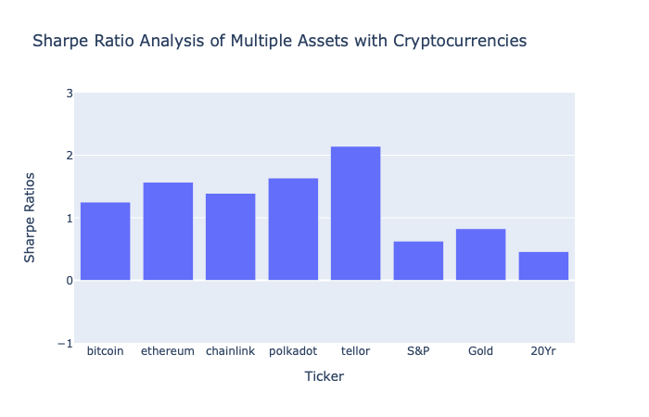
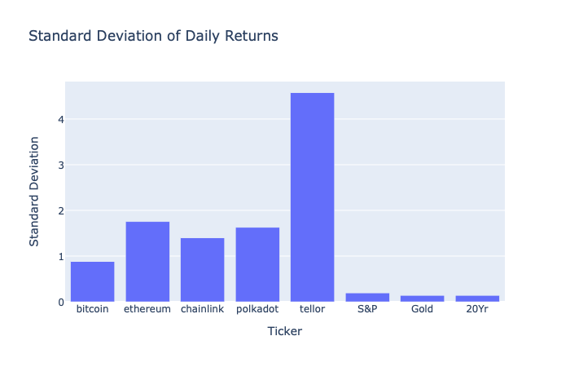
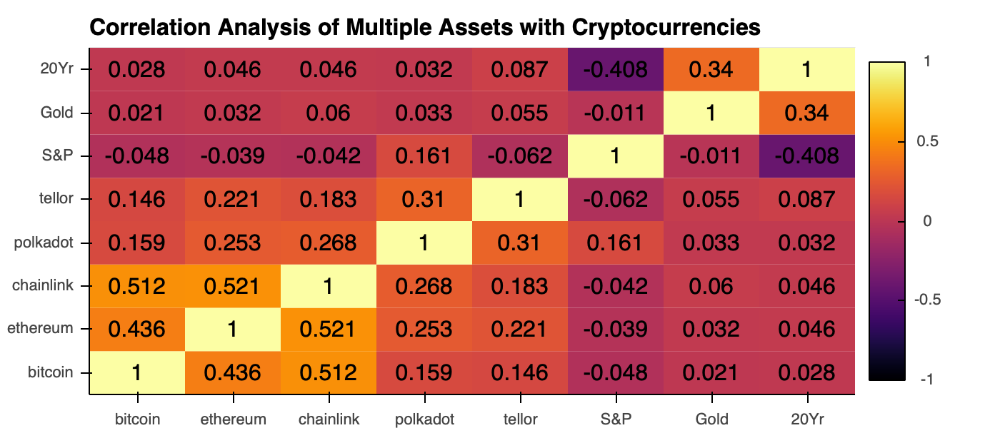
Data Analysis
The project successfully answered the majority of the user questions as follows:
What is the risk level of my portfolio?
How are my assets correlated?

Slide 6
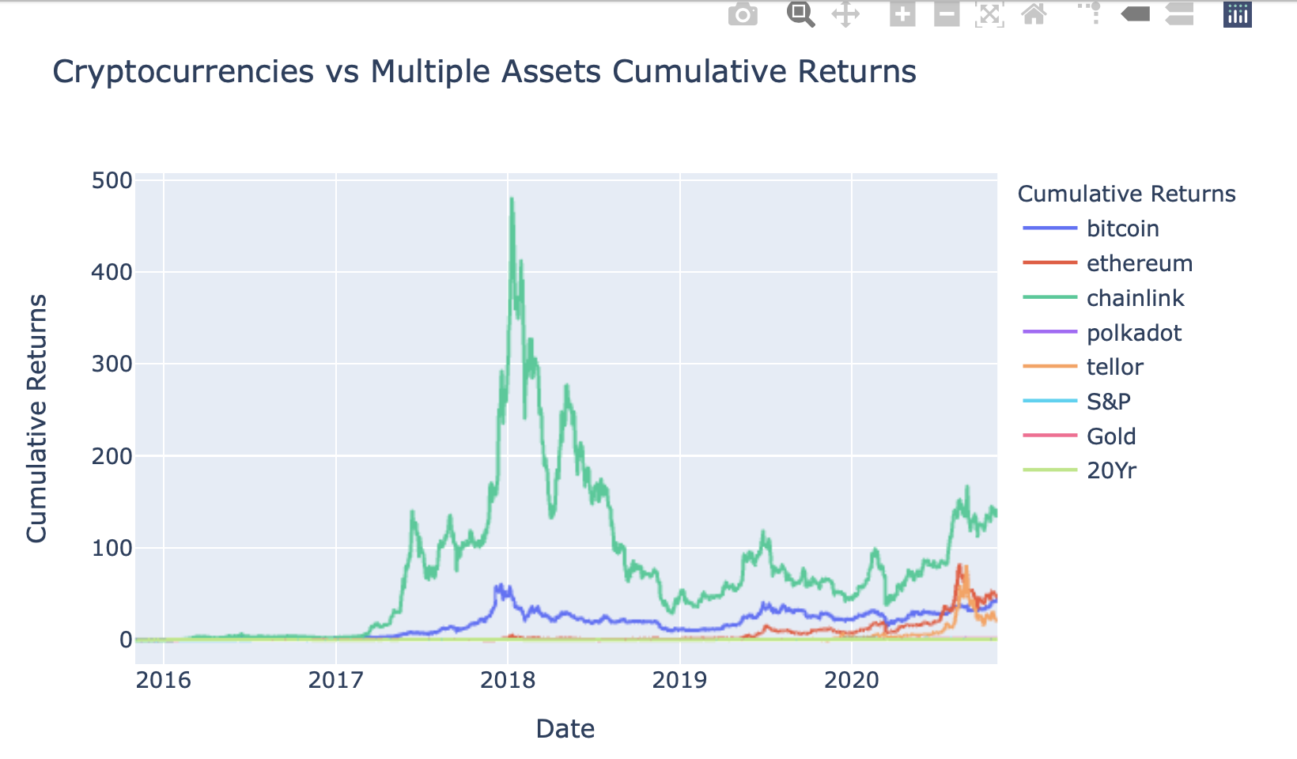
Data Visualization
How is my crypto performing
relative to other benchmarks?
The following questions will become part of the next phase of the project due to the charting complexities it will resolve:
What and how do we define a low/medium/high risk portfolio?
How can I construct a low/medium/high risk portfolio?

Slide 7
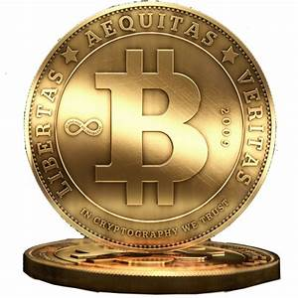

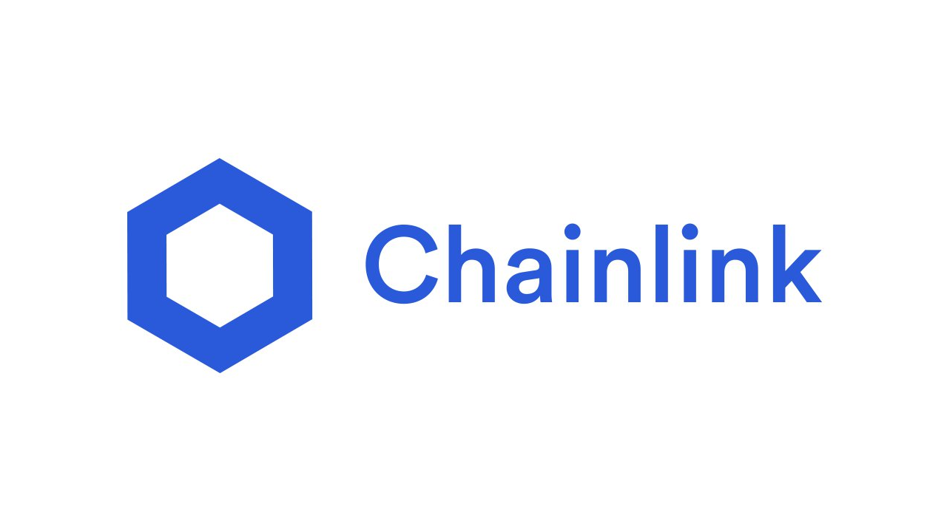
Findings
We know how crypto assets are correlated to each other.
Most Correlated Least Correlated
We have the ability to measure performance. The highest performing asset in our portfolio was
In the future, tracking historical changes in social media metrics may provide a leading indicator in cryptocurrency performance.

Slide 8

Conclusion
A real-time cryptocurrency portfolio analysis is possible and worthwhile.
The data provided unexpected results and proves the value of visualizations in analysis.
The complexities of evaluating this data is challenging due to the infancy of the crypto space.

Slide 9
Working Challenges
Streamlining the datetime index that came through the API into the UNIX date format.
Incorporating the level of user interactivity that we initially sought.
If the project was extended by two weeks, our team would:
Perfect the visualization and incorporate more interactivity
Develop the user experience to include cryptocurrency selections and establishing risk tolerances

Slide 10
Questions

Slide 11
Thank you!

